Slide 1
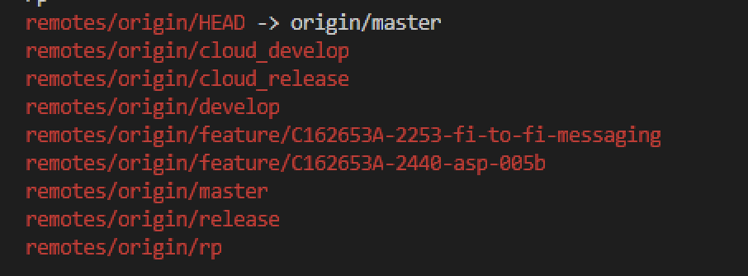
Branch creation
Develop branches

Slide 2
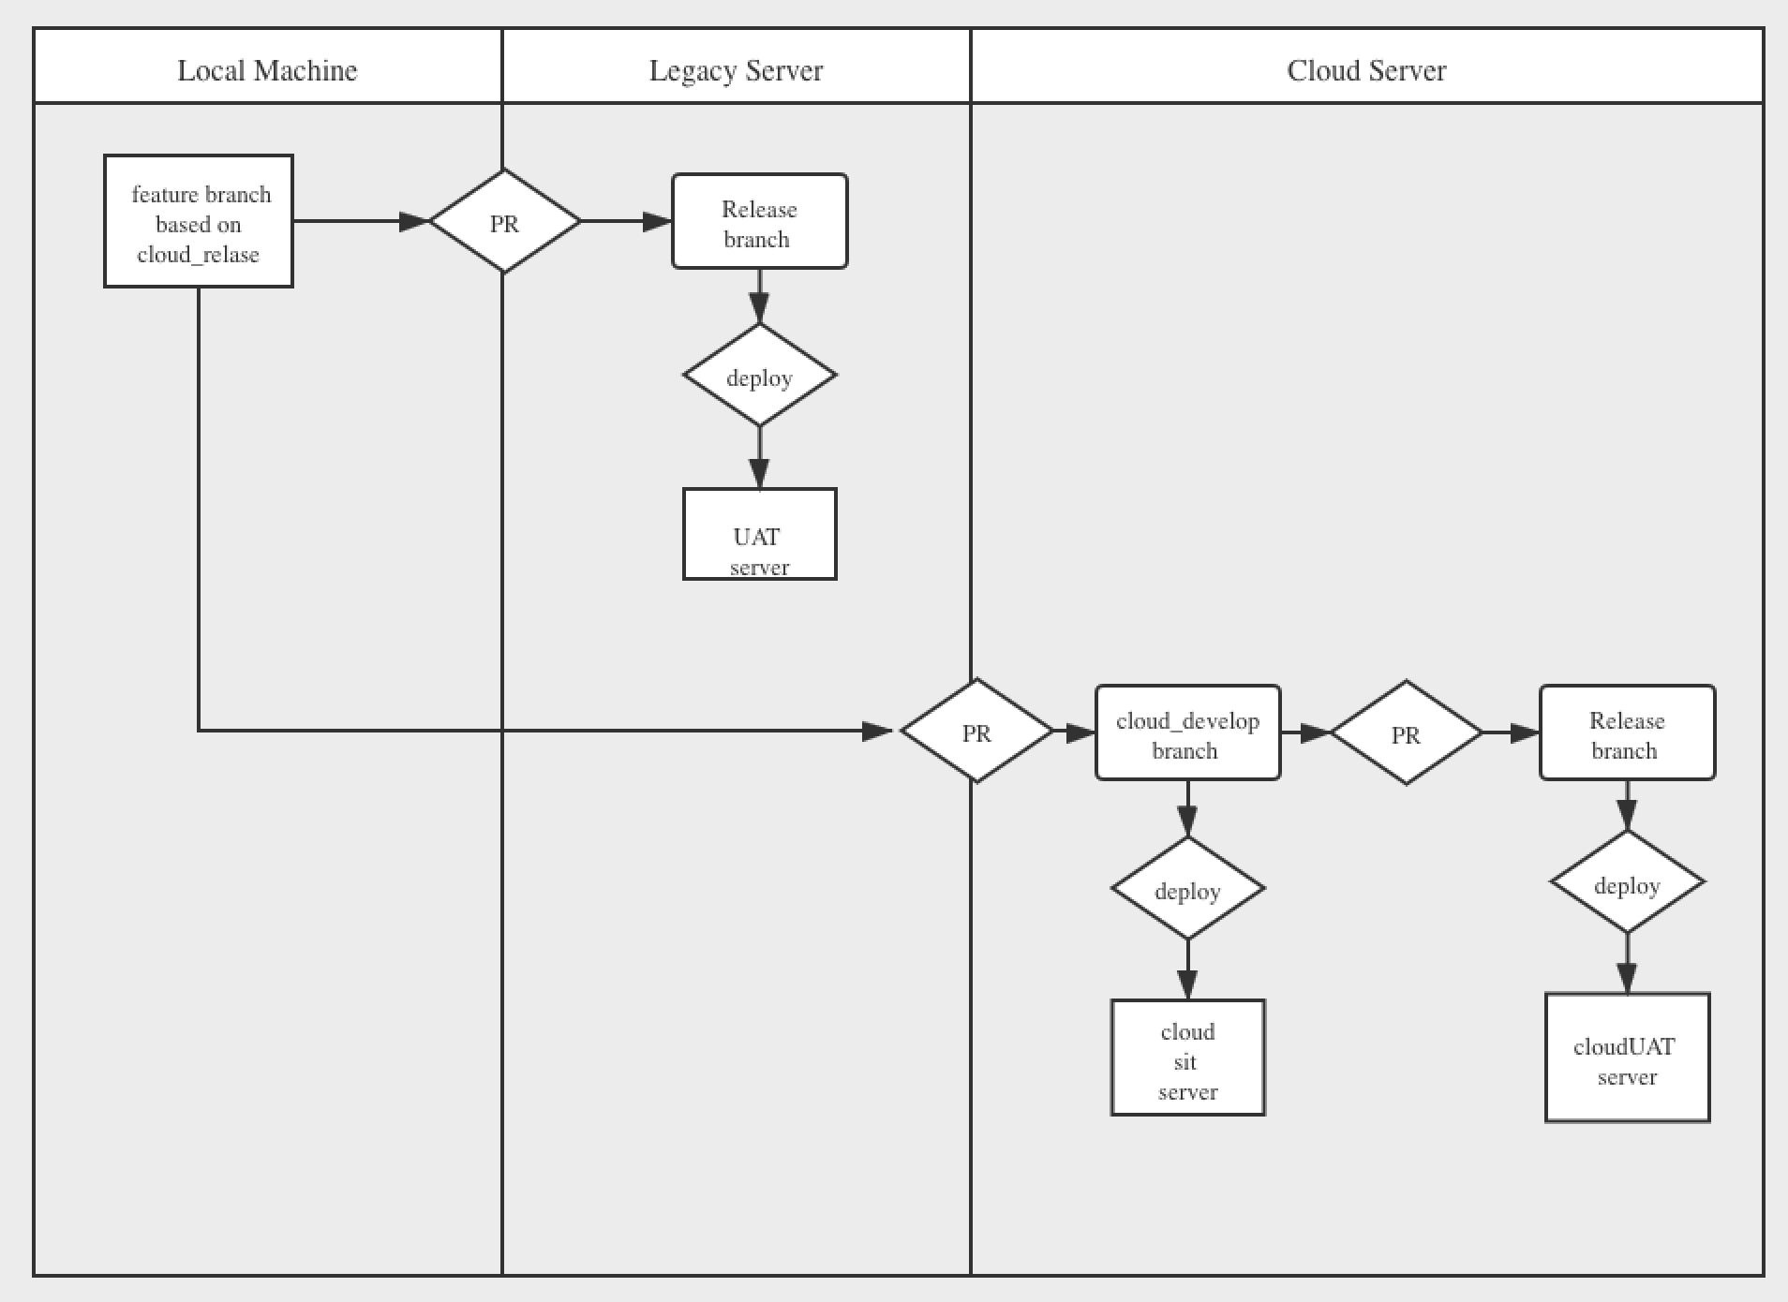
Branch creation
Develop Process Attention: don’t merge build.gradle

Slide 3
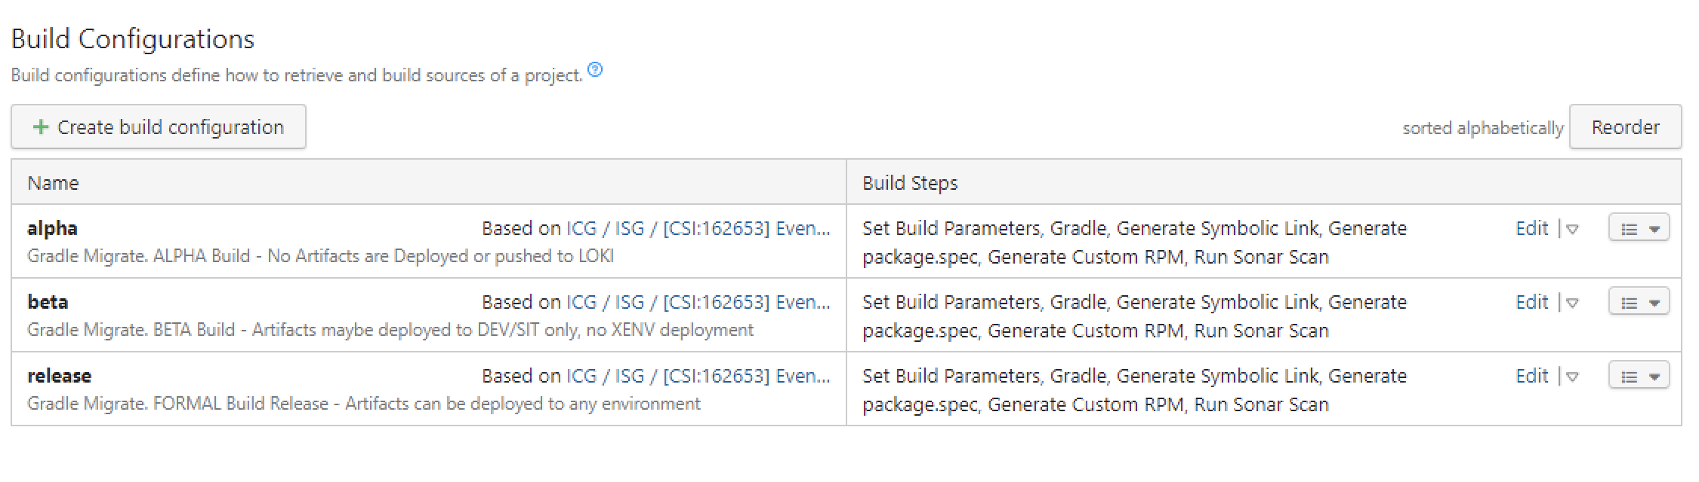
Rpm Generation
Set configurations
Alpha → feature Beta → develop branch Release → release branch

Slide 4
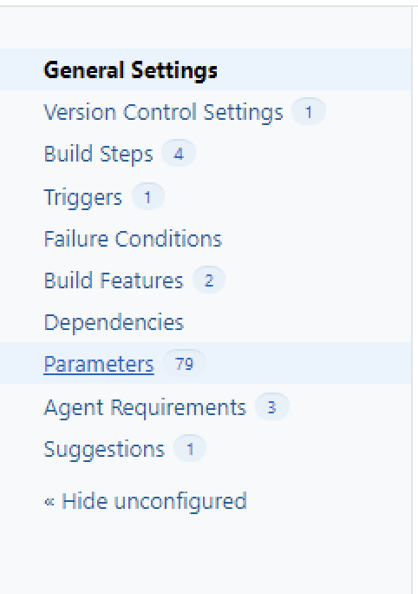
Rpm Generation
Set configurations
Choose parameter item

Slide 5
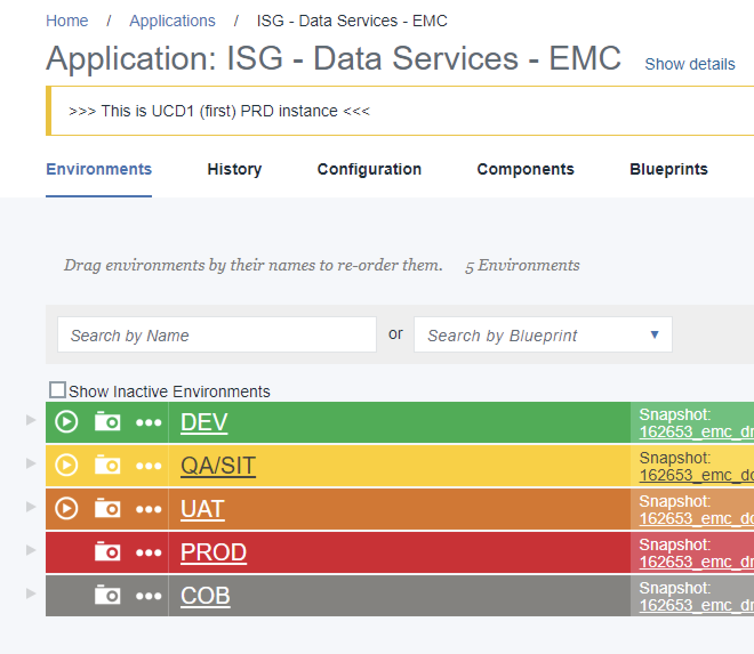
Package installation
Choose env to install

Slide 6
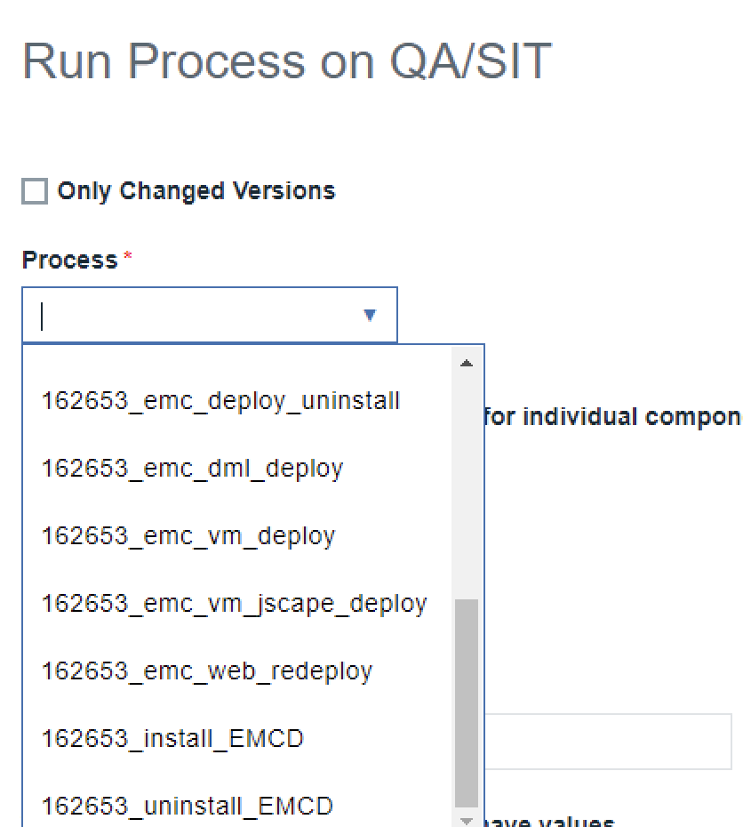
Package installation
Choose process 162653_emc_deply → legacy 162653_emc_vm_deply → cloud

Slide 7
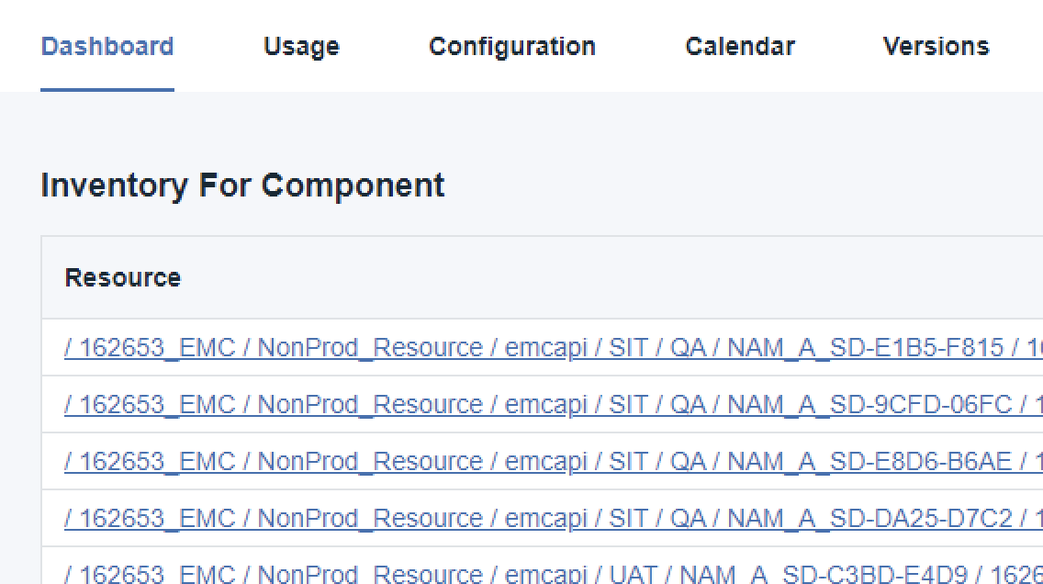
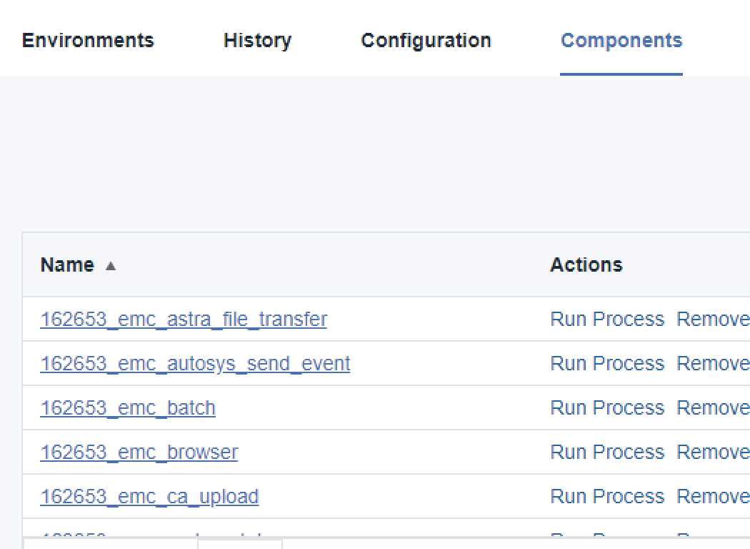
Package installation
Add version UAT Ready → UAT TESTED→ PROD

Slide 8

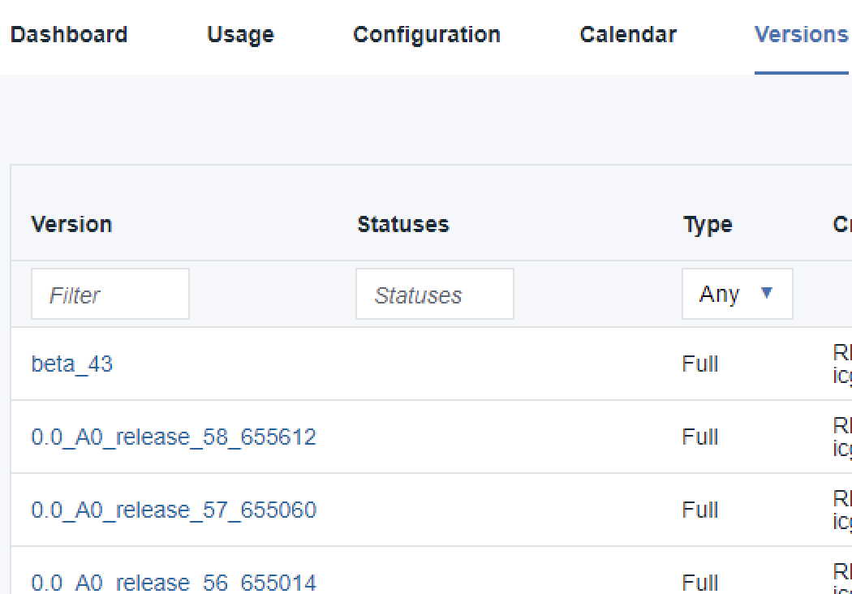
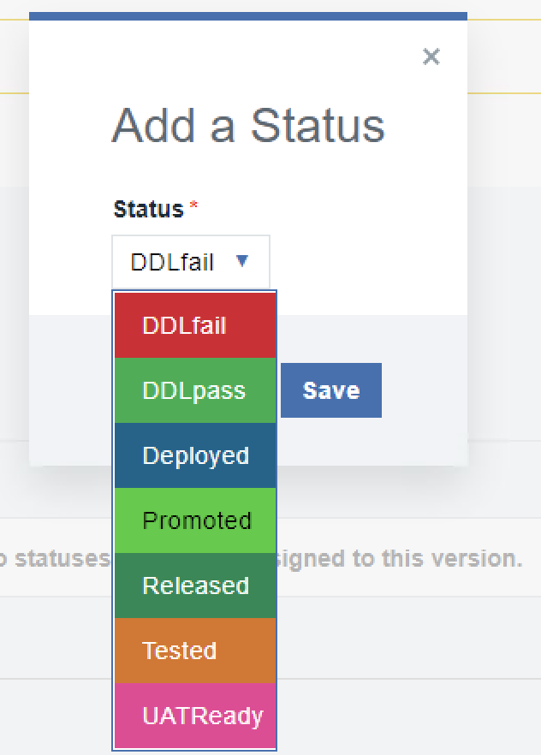
Package installation
Add version UAT Ready → UAT TESTED→ PROD

Slide 9
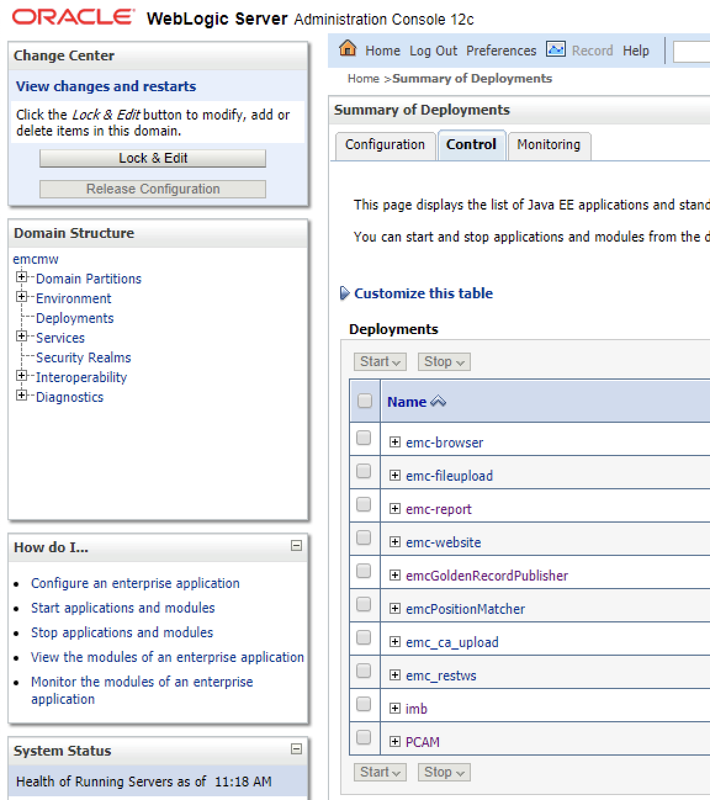
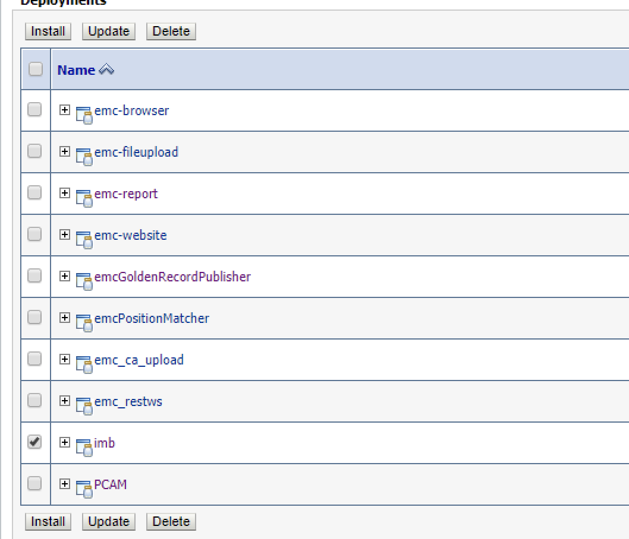
Weblogic update

Slide 10
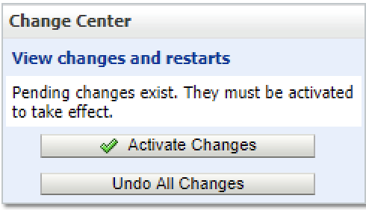
Weblogic update

Slide 11
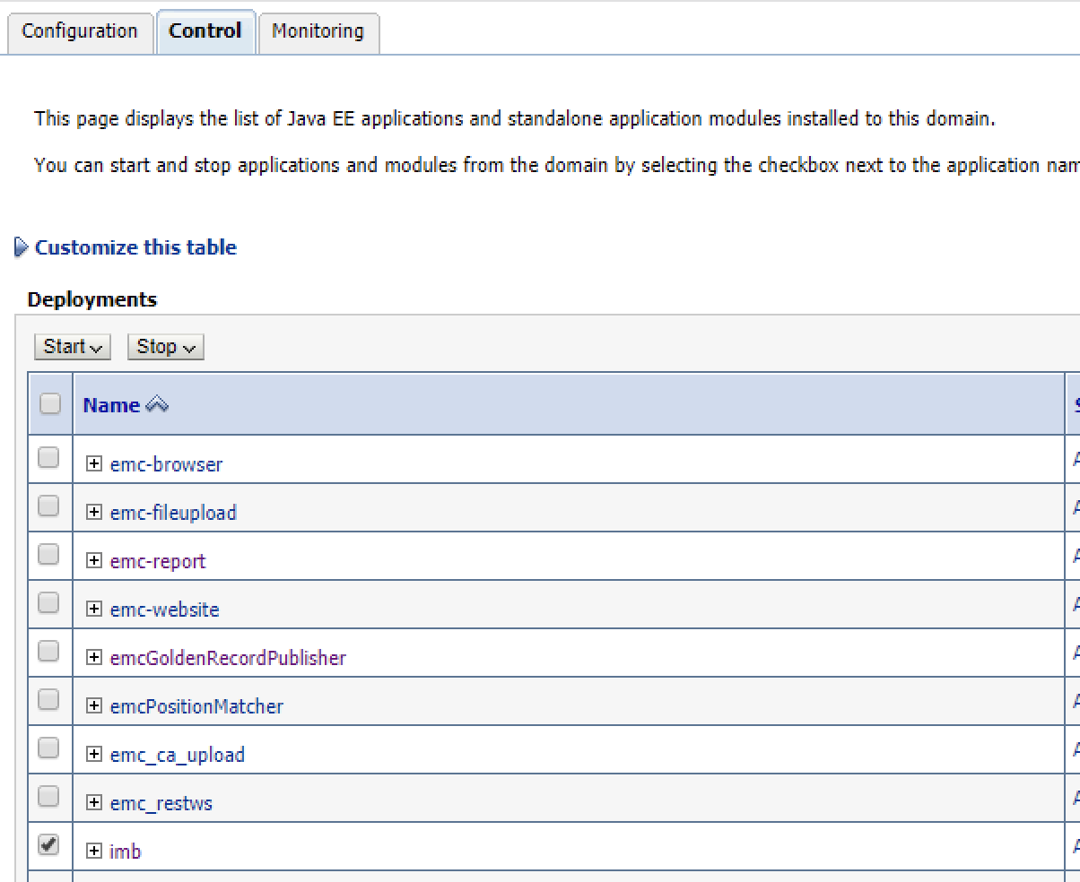
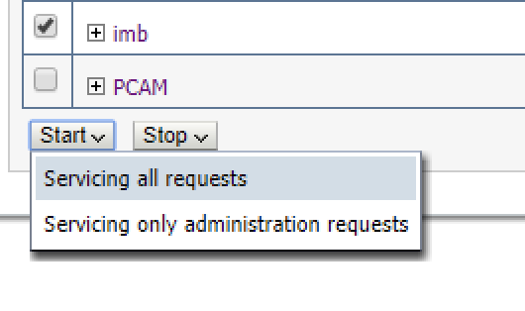
Weblogic update
First install start needed

